Slide 1
Spotify Web API
Chrome Extension
Tristan Dasilva, Justin Elmourne, Alex Grigoratos

Slide 2
Project Description
Our project is a Spotify Web API Google Chrome Extension.
It enables users to play music from their Spotify account directly in their Chrome browser. It also keeps users informed about nearby concerts tailored to their music taste.
Alongside these core functionalities, the extension offers convenient features like light/dark mode, the ability to save favorite concerts, and a toggle for the concert list view.

Slide 3
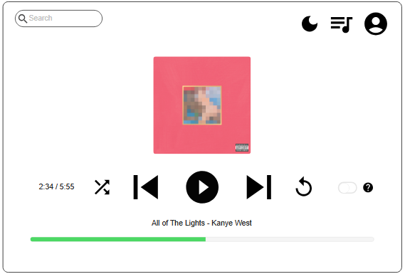
Spotify Track Player
Standard playback options
Shuffle, repeat
Track name, artist, album artwork
Search feature

Slide 4
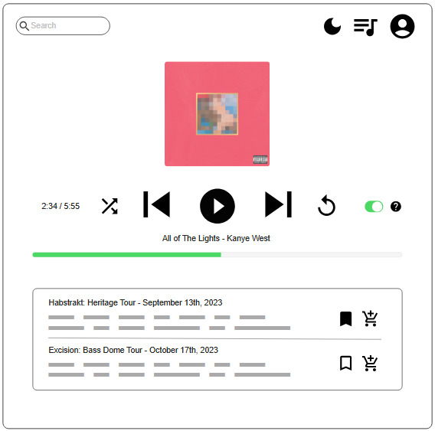
View Concerts
Toggle on to view concerts
Artist name, tour name
Concert date
Link to buy tickets
Save to favourites

Slide 5
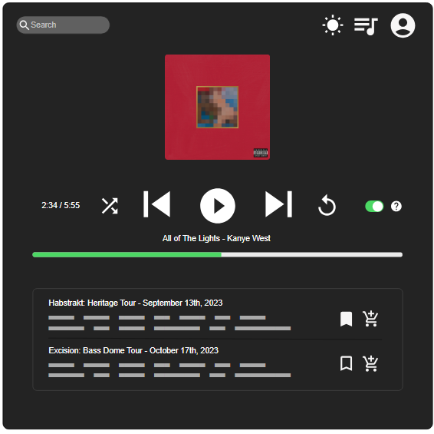
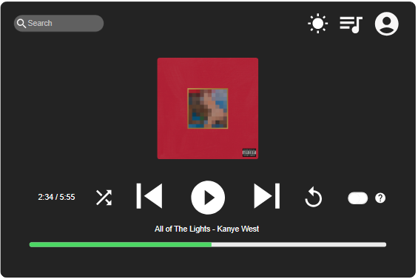
Dark Mode

Slide 6
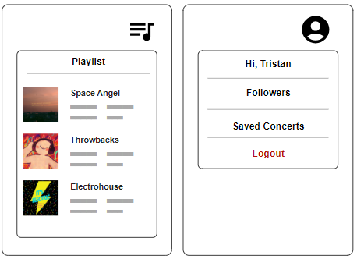
Playlist/Account
Profile picture
Select and play any playlist
Display number of followers
Display saved concerts
Logout of spotify

Slide 7
Other Information
Number of screen flows: 6 screens
Chosen Database: PostgreSQL
Github: jelmourne/chromium-music-player
Mockup: app.moqups.com/BDEUpJJ4Kf6EYzsYUYcXZNmmrxpgrpsQ/view/page/ad64222d5

